Slide 1
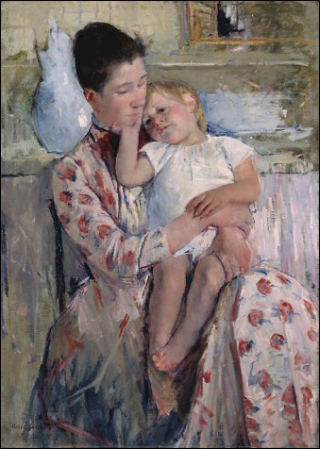
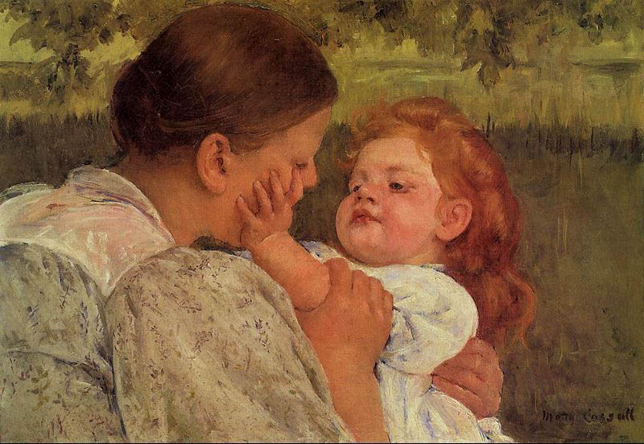
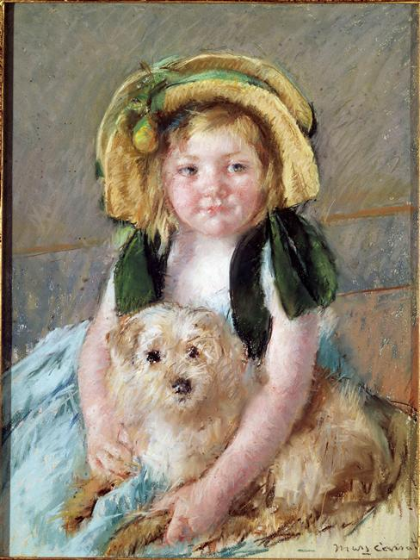
Unit 2: RELATIONSHIPS MARY CASSATT LTC 4240: Art for Children Created by Mary Franco

Slide 2
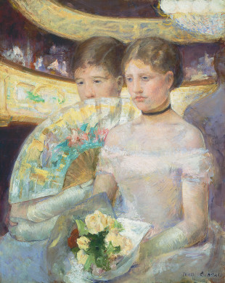
Cassatt’s art reflects a multiplicity of RELATIONSHPS
INTERPRESONAL RELATIONSHIPS between her models communicated through gaze and expression; gesture, posture, and proximity; muted colors and soft edges
COMPARATIVE RELATIONSHIPS
between men’s and women’s
experience of their world
STYLISTIC RELATIONSHIPS with
work of other artists and cultural art
traditions
Mary Cassatt
“The Loge,” 1882

Slide 3
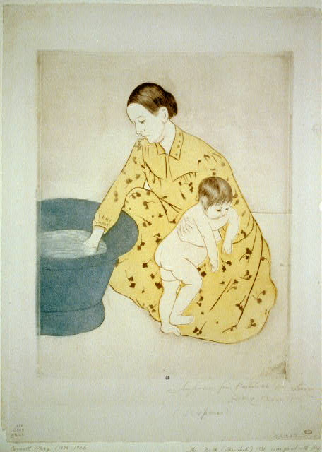
Cassatt’s Prints reflect. . .
a fused Japanese aesthetic with
Western printmaking techniques
Drypoint – image incised
into print plate with “needle”
Aquatint – print plate of
copper covered with powder
blocking agent; marks cut
into it with acid to permit
subtle color tones
Mary Cassatt, “The Tub,” 1891
Drypoint, Aquatint, Hand-coloring

Slide 4
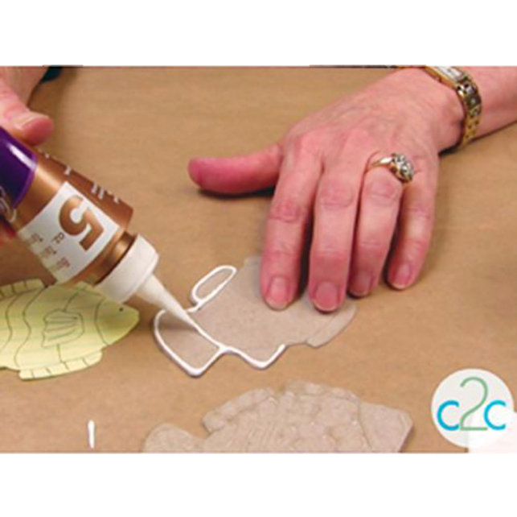
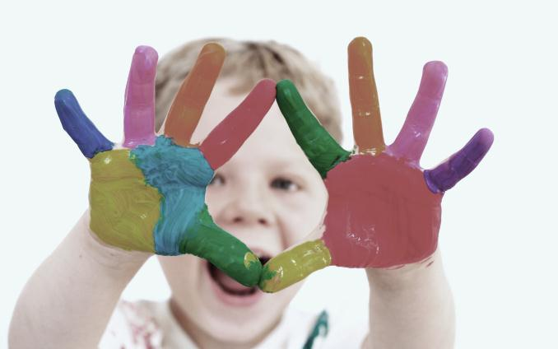
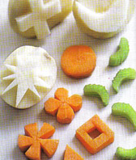
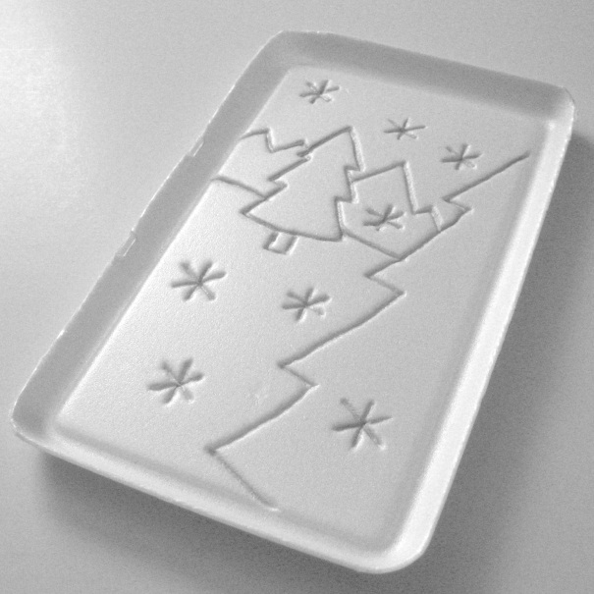
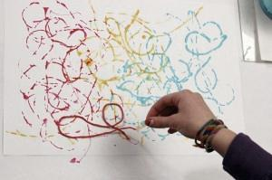
Prints can be created in other ways!
fingers & hands
vegetables & fruits
glue lines
Styrofoam / scratch foam
string painting

Slide 5
STUDIO ACTIVITY
DESIGN PROBLEM: TSW create a series of original prints from one print plate to depict an important relationship.
OPTION 1: Collograph and Frottage
TSW make a simple drawing on cardboard or cardstock
of an important RELATIONSHIP
TSW add at least three layers of cardboard or cardstock for dimension to create a matrix for printing
TSW use a brayer and printing ink to produce a series of 3 prints from the matrix
TSW clean the matrix after printing and use it to produce one or more crayon rubbings (frottage prints)

Slide 6
STUDIO ACTIVITY
DESIGN PROBLEM: TSW create a series of original prints from one print plate to depict an important relationship
OPTION 2: Faux Drypoint with Hand Coloring
TSW make a simple drawing of an important RELATIONSHIP on thin paper (approx. 6” x 9”)
TSW tape drawing to Scratch foam of the same size and
trace over the lines with pencil to incise the image into the
face of the Scratch foam. This produces a matrix.
TSW register the matrix to print paper with painter’s tape.
Using water-based markers, TSW color the matrix, section by section, and print image onto the print paper. Matrix will be cleaned and process repeated with new colors to create a second print.

Slide 7
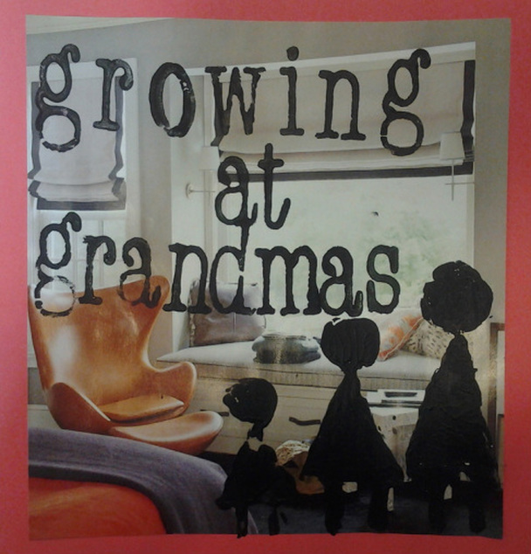
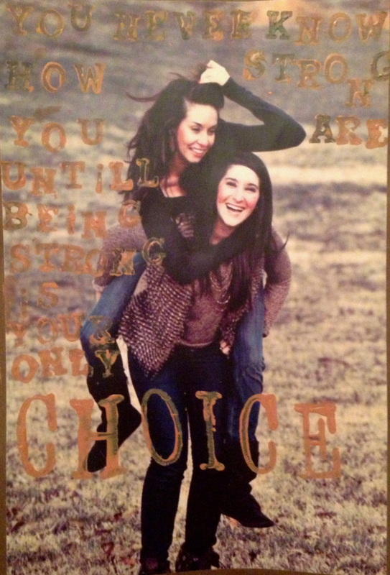
Notes:
Rachel Newman
Abbi Sandweiss

Slide 8
References
Cassatt, M. (1896). [Image]. Maternal caress. Philadelphia Museum of
Art. Retrieved from http://www.philamuseum.org/
collections/permanent/66441.html
Cassatt, M. (1890). Mother and her child. Wikipaintings. Retrieved from
http://www.wikipaintings.org/en/mary-cassatt/mother-and-
child-1
Cassatt. M. (1901) [Image]. Sara with her dog. Wikipaintings.net.
Retrieved from http://www.wikipaintings.org/en/mary-
cassatt/sara-with-her-dog
Cassatt, M. (1891). [Image]. The bath (the tub). Library of Congress. Retrieved from http://www.loc.gov/pictures/item/2002719192/
Cassatt, M. (1882). [Image]. The loge. National Gallery of Art. Retrieved
from http://www.nga.gov/collection/gallery/ggcassattptg/
ggcassattptg-46571.html

