Slide 1
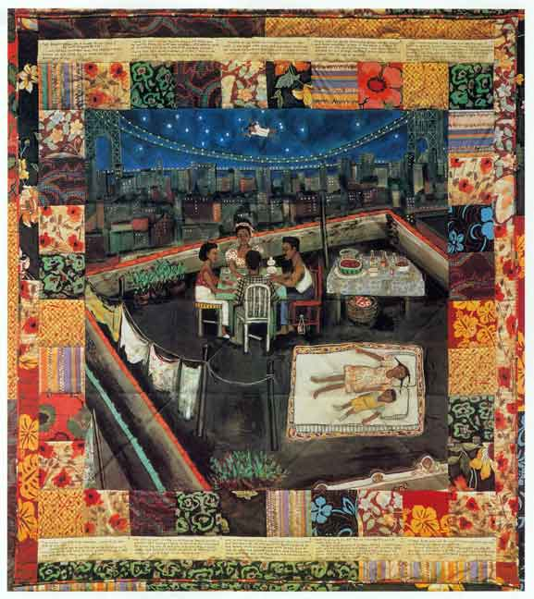
VTS

Slide 2
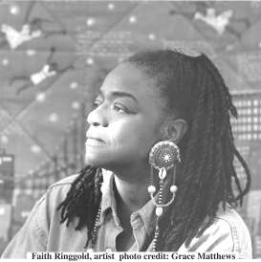
FAITH RINGGOLD
Unit 3: Stories

Slide 3
Faith Ringgold’s story…
Faith Ringgold was raised in Harlem, New York, during Harlem’s golden age of music (jazz), theater, and literature.
In the late 40s women were not allowed to enroll in University Liberal Arts programs, except through education programs.
She taught art for 18 years, obtained a master of arts degree, and traveled to Europe with her children.
Ringgold merged her fine art skills with sewing skills to create her unique story quilts and sculptures. She has integrated history, language arts, and visual art into books and art pieces that teach, inspire, and entertain.
More information on Faith Ringgold:
http://www.artheritageprogram.org/Ringgoldbio.pdf

Slide 4
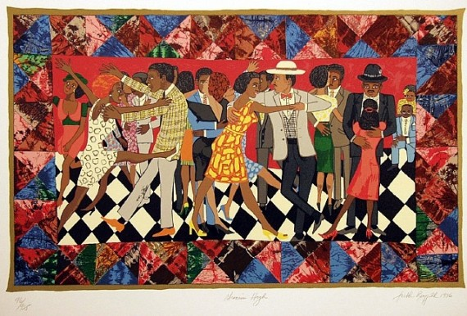
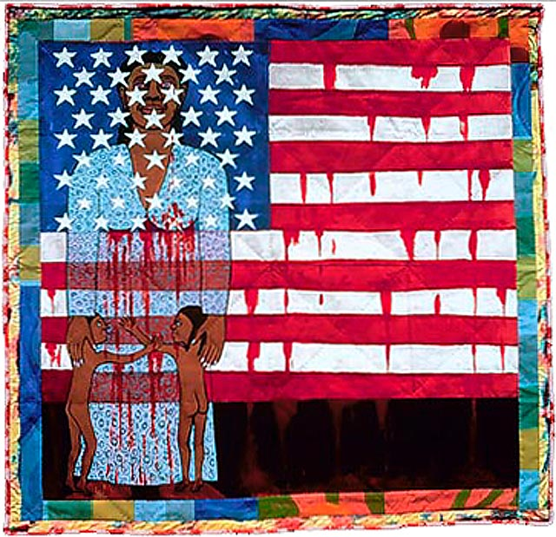
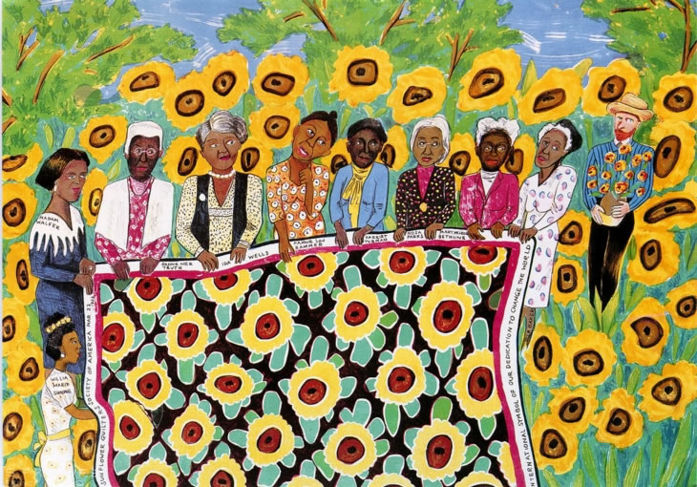

Slide 5
Essential Questions for Unit 3
How do stories convey personal/cultural identity?
How do stories demonstrate or reveal relationships?
How do stories help us make sense of the world?
What story qualities make them entertaining and/or intriguing?
How can stories inform? What knowledge can be gleaned from stories?
How do artists communicate stories through their art?
What story does your quilt tell us? What colors, textures, shapes, lines, and design did you use and how do they help convey your story?
What do you like most about your story quilt and why?
How could you use this lesson in your own classroom and with what content areas could you integrate and connect?

Slide 6
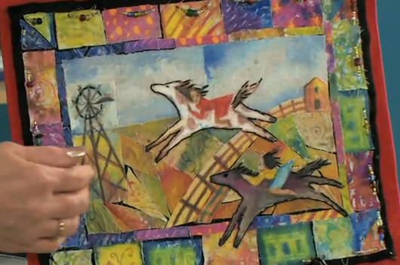

Slide 7
Painted Story Quilts
Learn more at: www.faithringgold.com
Faith Ringgold tells us how she created ‘Tar Beach’ (3:49): http://video.pbs.org/video/2229400016/
Studio
Painted Story Quilt with Crayon Resist:
http://www.dickblick.com/lesson-plans/painted-story-quilt/

Slide 8
Crayon Resist – Story Quilts
ART + SOCIAL STUDIES + LITERATURE
Prepare by selecting subject matter: a favorite book or story of your own to share
Sketch your ideas of a scene first (9” x 12”), plan on a border outside or inside of this space
Play with crayon resist - wax crayons and watercolor to form patterns, then use crayon resist to express your planned scene
Surround your finished scene with a border of colors and patterns painted or glued to the outside edge
This art form (quilt-making) can teach basic math skills, record history, recycle materials, and use cooperative efforts within a group

Slide 9
References
http://www.artheritageprogram.org/Ringgoldbio.pdf
www.faithringgold.com
http://video.pbs.org/video/2229400016/
http://cdn.dickblick.com/lessonplans/painted-story-quilt/painted-story-quilt-painted-story-quilt.pdf

