Slide 1
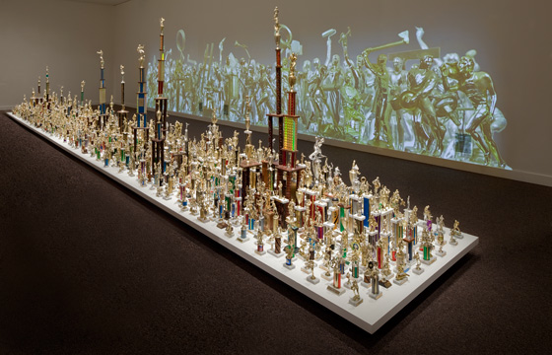
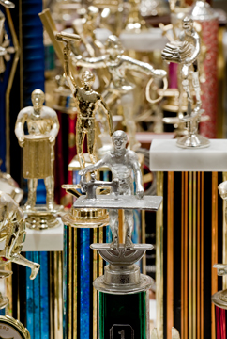

Slide 2
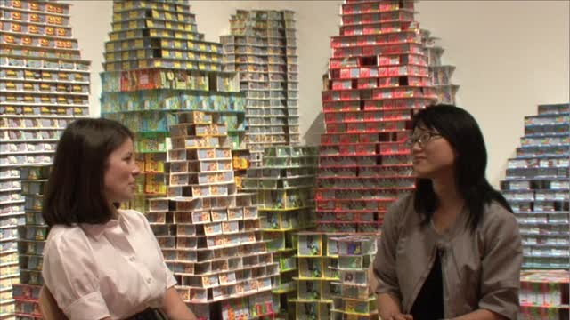
Jean Shin
Mini-Sculptures from Found Objects
LTC 4240
Created by Amber Ward

Slide 3
Stories . . .

Slide 4
Jean Shin Resources
Jean Shin “Common Threads” video (14:31) http://www.artbabble.org/video/saam/jean-shin-common-threads
Jean Shin: “Turning Trash into Artistic Treasures” audio (6:29) http://www.npr.org/templates/story/story.php?storyId=103674782

Slide 5
About the Artist
“Jean creates elaborate sculptures and site-specific installations that suggest imaginary communities through the use of accumulated cast-offs. Mary Ceruti writes, ‘Jean Shin uses discarded material (the excess, the forgotten, the no longer useful) in works that operate between abstraction and representation. Made from the remnants of contemporary urban life, Shin’s sculptures form a sort of visual history and a social mapping.’”
Source: http://www.location1.org/jean-shin/

Slide 6
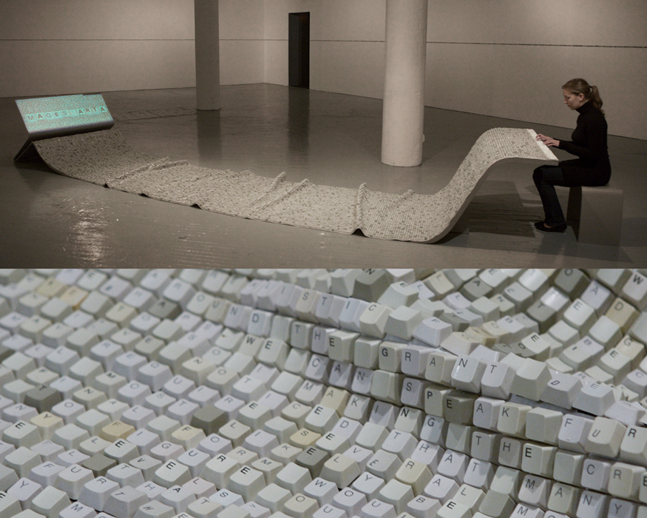
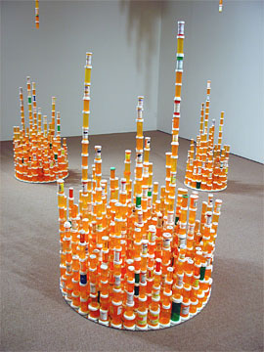
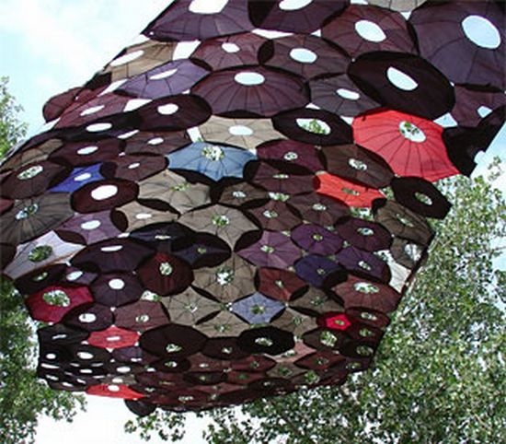
Chemical Balance,
2005-2009
TEXTile, 2006
Penumbra, 2003

Slide 7
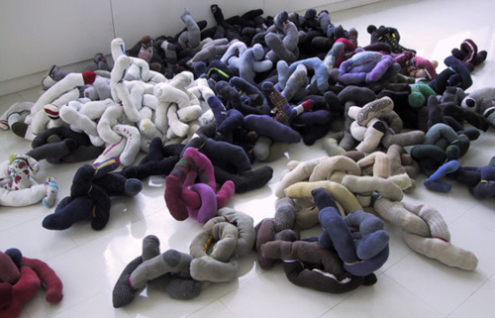
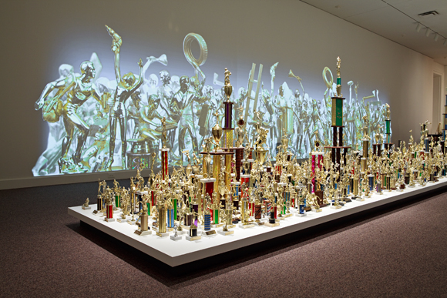
Lost and Found (Single Socks),
2000
Everyday Monuments,
2009

Slide 8
Mini-Sculptures from Found Objects
Select an object that is mass-produced, abundant, often discarded
Contemplate the object’s meaning or story (consider a button, for example)
Create a meaningful mini-sculpture that changes the meaning and/or story of the object
Sculpture may be freestanding, free hanging, or relief

Slide 9
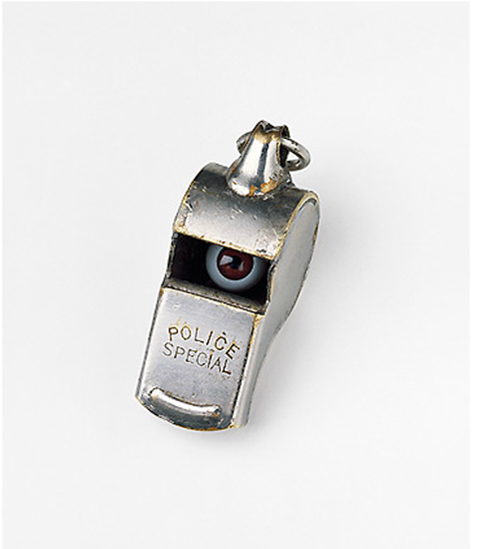
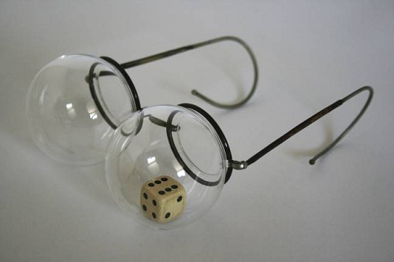
Examples

Slide 10
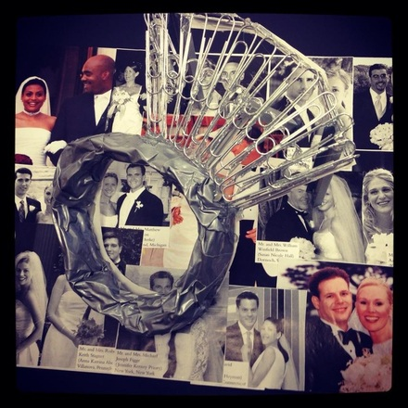
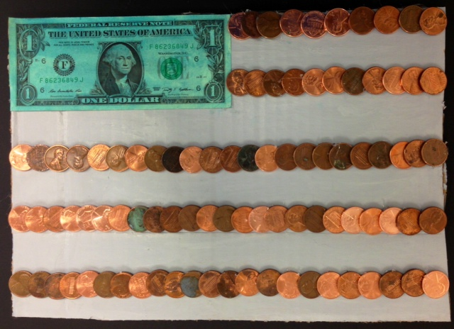
Examples
Notes:
Abbi Sandweiss and Shelby Enright
Haley Atkisson, Hope Ryan, and Callee Barrett

