Slide 1
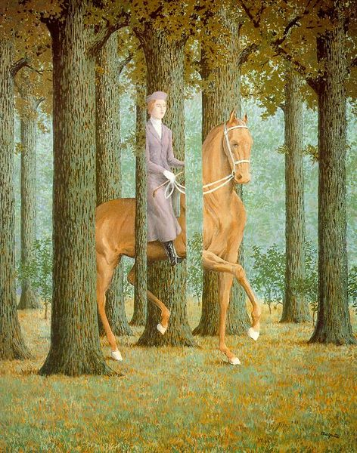
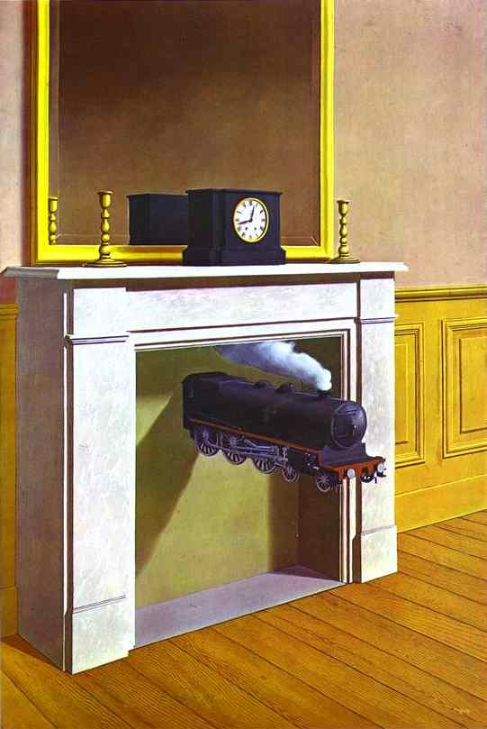
introduction to surrealism
RENE MAGRITTE
Unit 2: relationships
communicated through art and between people, places, things

Slide 2
surrealism explores fantasy, subconscious, dreams
“Art evokes the mystery without which the
world would not exist.”
“Everything we see hides another thing, we
always want to see what is hidden by what we see.” Rene Magritte
What do you see? (5:50 min.)

Slide 3
Amber Ward’s
Postcards

Slide 4
Movement originated in the 1920s
Focused expression on imagination, especially as it appeared in dreams
Surrealists used games to show the function of the subconscious and chance in the creation of art
Influenced by Sigmund Freud ‘Father of Psychoanalysis’

Slide 5
Materials needed:
Magazines
Glue stick
Scissors / craft knife
3” x 5” cards
Pencil
Colored pencils
Music

Slide 6
Create a collective surreal scene for an imaginary voyage postcard: Rene Magritte Lesson Plan
Choose and tear-out 10 magazine pages with rich imagery; return magazines
Obtain two 3” x 5” cards; write your name small with pencil on the back of both at the bottom right
Adhere background on each card using glue stick; cut or tear off excess from edges > pass your card to the left when music stops (on command)
Select and cut 1st image from your magazine cache for each new postcard (do NOT glue) > pass on command

Slide 7
studio cont’d.
Examine existing work; add to collaboration by selecting and cutting 2nd image from your cache for each postcard (no NOT glue); attempt to add variety through color and size > pass on command
Repeat above step for 3rd image > pass on command back to original owner
Owner: channel Magritte, Bang and Matisse by arranging items before gluing, objects may overlap
On back, design a stamp using colored pencil, and write to someone about your surreal voyage
Finished early? Create more surreal postcards either on your own or with a friend
Etc. for elementary classroom: ask students to keep dream journals

