Slide 1
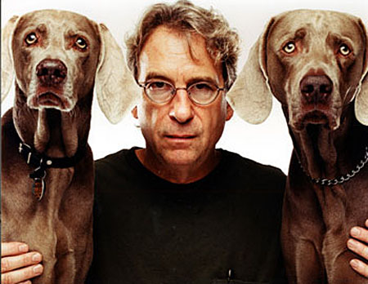
Unit 1: IDENTITY William Wegman
LTC 4240: Art for Children
Lesson Design by Mary Franco

Slide 2
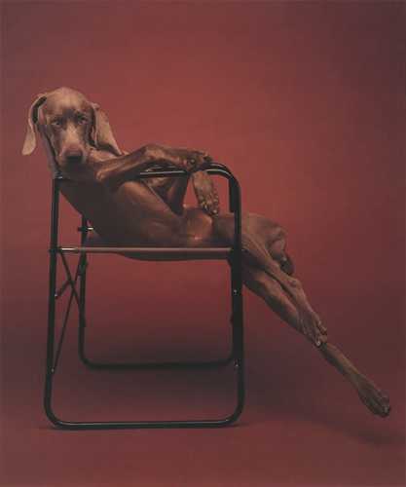
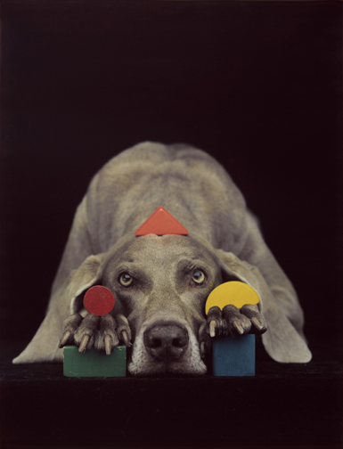
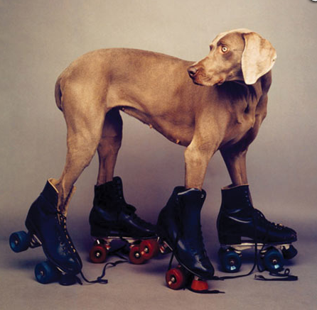
video introduction to Artist William Wegman
William Wegman Talks Dog (3:41)
http://www.youtube.com/watch?v=xdI_SWIhn-E
In the Company of Animals: Wiliam Wegman
On Dogs and Photography (4:36)
http://www.youtube.com/watch?v=FUAdNCz0D94

Slide 3
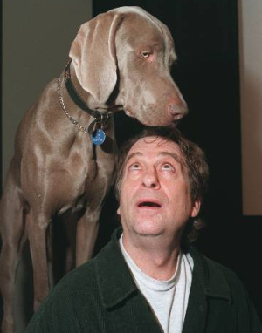
Artist’s Biography
Although Wegman received BFA and MFA degrees in painting, he has become known as a conceptual artist and “dog photographer” who collaborates with Weimaraners.
Man Ray was his first canine subject. From 1970-1981, Wegman and his dog shared “a long and fruitful collaboration” (Wegman, 2013).
Five years after Man Ray’s death, Wegman got Faye Ray; several of her progeny became Wegman collaborators as well.
Wegman & Faye Ray

Slide 4
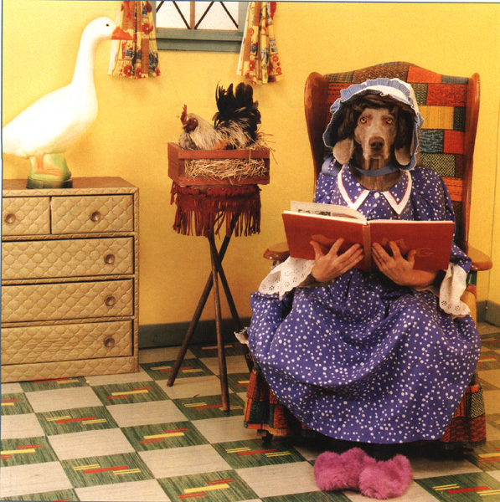
Wegman transforms IDENTITY through Anthropomorphism
Anthropomorphism - “attribution of human characteristics to other animals, non-living things, phenomena, material states, objects or abstract concepts” (Wikipedia, 2013).
a.k.a. personification
Personification is used often in art & storytelling.
In fables of many cultures, it is used as a non-threatening teaching strategy.

Slide 5
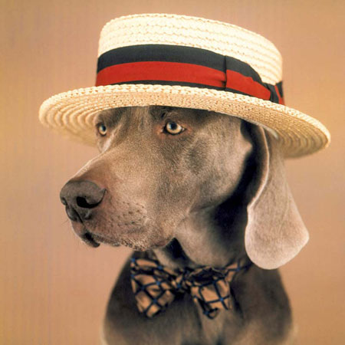
Wegman’s Weimaraner Photographs are about IDENTITY
Through anthropomorphism, he imposes contrived IDENTITIES upon the Weimaraners using costumes, props, poses and settings.
In the process, they have become not merely models or subject matter, but collaborators in his art.
Through transforming the dogs’ IDENTITIES as art, they have transformed Wegman’s.

Slide 6
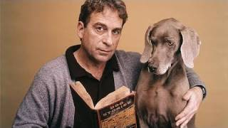
Wegman’s Weimaraner Photographs are also about RELATIONSHIPS
Anthropomorphic RELATIONSHIPS between the Weimaraners and the humans they represent.
Empathetic RELATIONSHIPS between viewers and Wegman’s canine characters.
Wegman’s own loving
RELATIONSHIPS with
the dogs he calls his
“collaborators.”

Slide 7
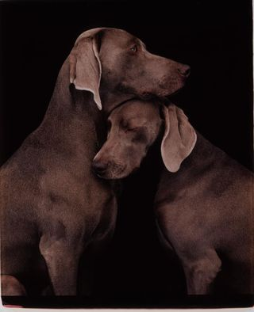
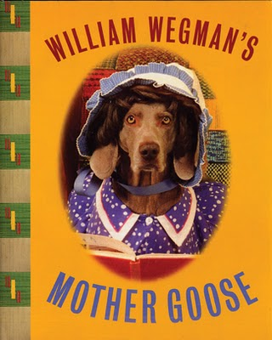
William Wegman’s Weimaraner photographs are about STORIES
Subtle, ambiguous stories that beg contemplation.
Much more obvious stories
that delight and entertain.

Slide 8
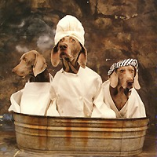
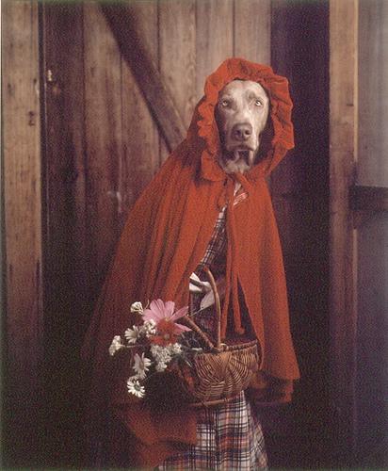
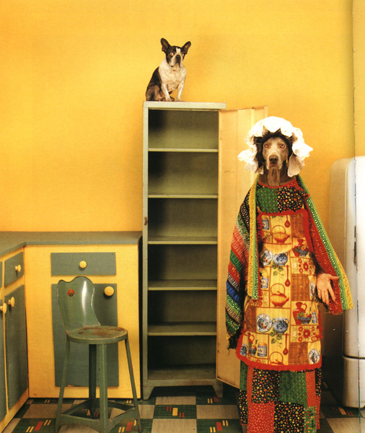
Wegman Fairytale Characters (Can you tell who is who?)
How did Wegman communicate the characters’ IDENTITIES?

Slide 9
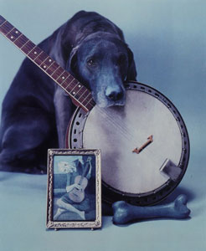
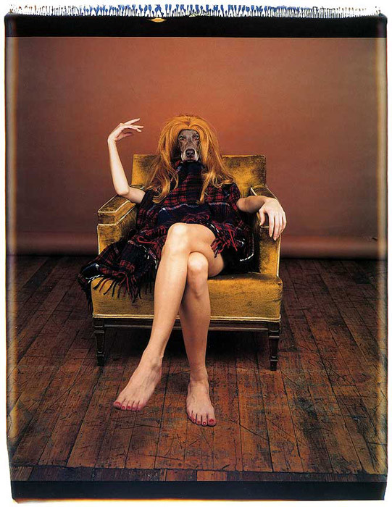
What can you tell about the IDENTITIES of these Wegman characters?
How did Wegman communicate the characters’ IDENTITIES?

Slide 10
STUDIO ACTIVITY: Mixed Media Personifications
Design Problem: use PERSONIFICATION to communicate the IDENTITY of a familiar character from fairytale, fable, or other narrative.

Slide 11
A few Fairytales and Fables
The Boy who Cried Wolf (1:10 – 6:50)
Hansel and Gretel
Little Red Riding Hood
Rapunzel
Rumpelstiltskin
Rip Van Winkle
The Happy Prince

Slide 12
STUDIO ACTIVITY: Mixed Media Personifications
Select a narrative and character as the subject.
Select an animal whose commonly recognized
characteristics complement the IDENTITY of the
selected character.
3. Combine animal and human imagery using 3 or
more mediums (art materials) to render the
personification.
4. Consider costume, expression, gesture, props,
setting, etc. as IDENTITY clues for the viewer.

Slide 13
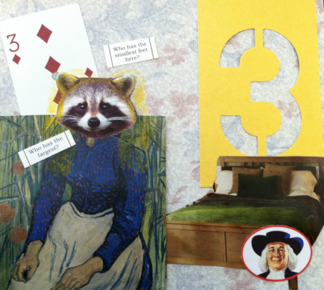
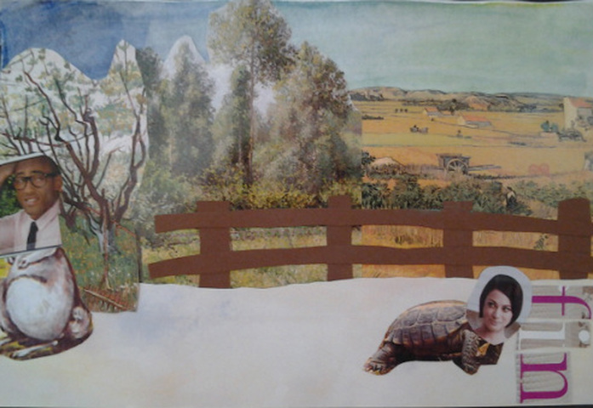
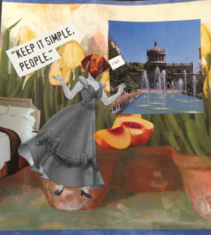
Notes:
Artists:
Hope Ryan
Rachel Newman
Sarah Moore

Slide 14
References
Wegman, W. (2013). [Artist’s website]. Retrieved from
http://www.wegmanworld.com/about.html
Wegman, W. (1994). [Image]. On set. Retrieved from
http://artblart.com/tag/william-wegman-fay/
Wegman, W. (1996). [Image]. William Wegman’s Mother Goose. Retrieved
from http://eclipse.rutgers.edu/shared/image.jsp?iid=00780000
Wegman, W. (2007). William Wegman talks dog. Retrieved from
http://www.youtube.com/watch?v=xdI_SWIhn-E
Wikipedia (2013). Anthropomorphism. Retrieved from
http://en.wikipedia.org/wiki/Anthropomorphism
Wikipedia (2013). [Image]. Blue period with banjo. Retrieved from
http://en.wikipedia.org/wiki/William_Wegman_%28photographer%29

