Slide 1
Subconscious Exploration
Concept, or Big Idea:
Identity
Choice of Mediums: Sharpie & colored pencils
Art Methods & Techniques: Automatic Drawing
ART 133, Art Education for Children
Professor: Amber Ward

Slide 2
“Automatic drawing . . . was developed by the surrealists [circa 1920s], as a means of expressing the subconscious. In automatic drawing, the hand is allowed to move ‘randomly’ across the paper. In applying chance and accident to mark-making, drawing is to a large extent freed of rational control. Hence the drawing produced may be attributed in part to the subconscious and may reveal something of the psyche, which would otherwise be repressed.” “Automatic drawing was pioneered by Andre´ Masson. Artists who practiced automatic drawing include Joan Miro´ , Salvador Dali, Jean Arp, and Andre´ Breton.” Source: http://en.wikipedia.org/wiki/Surrealist_automatism

Slide 3
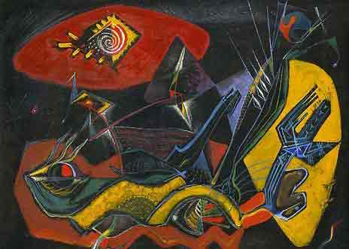
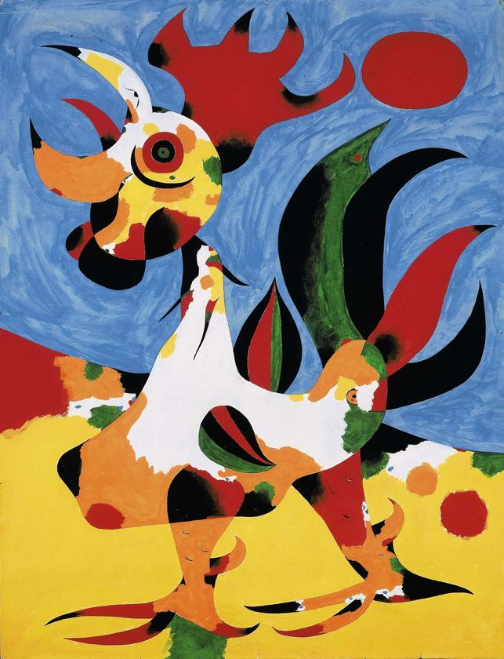
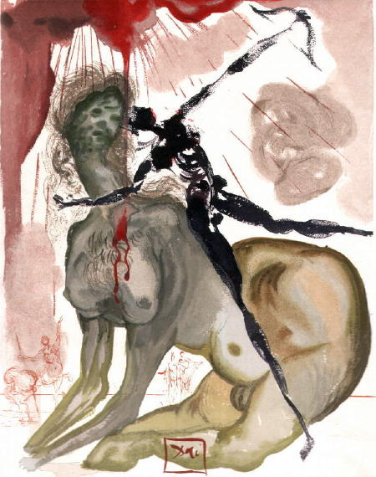
Andre´ Masson
Joan Miro´
Salvador Dali

Slide 4
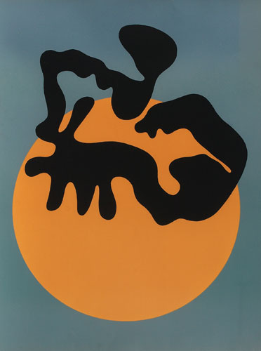
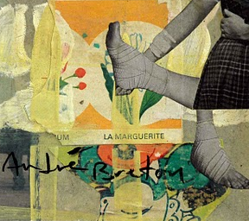
Andre´ Breton
Jean Arp

Slide 6
How do I create an automatic drawing?
Obtain paper and sharp pencil.
Relax! Let your mind wander or “go blank.”
When ready, begin drawing slowly and lightly. You may choose to (1) close your eyes, (2) look away from, or (3) look at your paper.
When drawing, work very hard at letting your subconscious take over.
Continue drawing until you feel finished, a few minutes perhaps.
Stop and “read” the lines. What has presented itself to you? And why?
Look at your drawing and emphasize objects that seem to advance toward you by darkening those lines with sharpie.
Erase insignificant lines.
Share your work with a peer. Share thoughts.
Add value using COLORED PENCIL (mix colors by crosshatching).

