Slide 1
Unit 3: Stories Thomas Hart Benton and Diego Rivera
Art for Children SP 2013

Slide 2
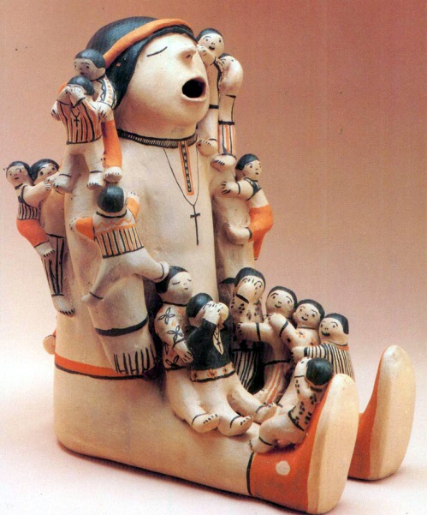
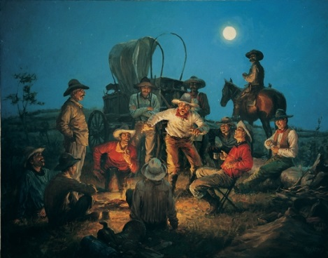
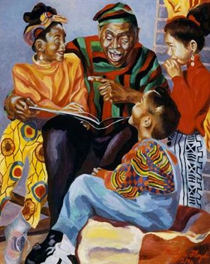
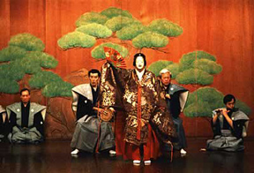
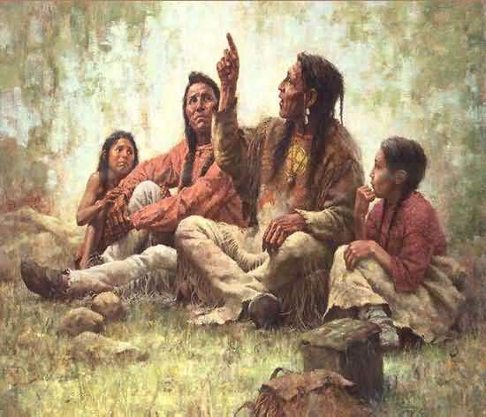
Big Idea: STORIES
Throughout history and across cultures, people have created and communicated stories for many reasons.

Slide 3
Stories: Key Concepts
Stories communicate personal and cultural identity.
Stories demonstrate/reveal relationships.
Stories help us make sense of the world.
Stories inform as well as entertain/intrigue.
Visual artworks are "texts,” and their narratives can be read.
Stories can be expressed/communicated through art.

Slide 4
Stories: Essential Questions
How do stories communicate personal and/or cultural IDENTITY?
How do stories demonstrate/reveal RELATIONSHIPS?
How do stories help us make sense of the world?
What qualities of stories are entertaining and/or intriguing?
How can stories inform? What kind of information and/or knowledge can be gleaned from stories?
How do artists communicate stories through their art?

Slide 5
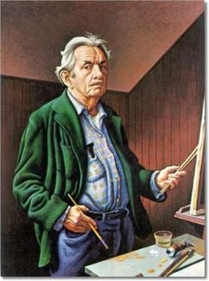
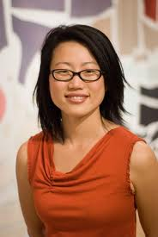
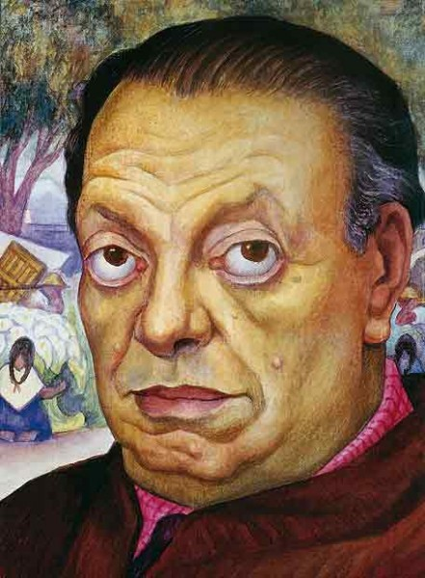
Artists who are VISUAL STORYTELLERS
Thomas Hart Benton
Faith Ringgold
Diego Rivera
Jean Shin

Slide 6
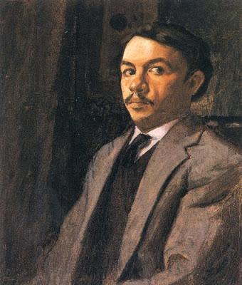
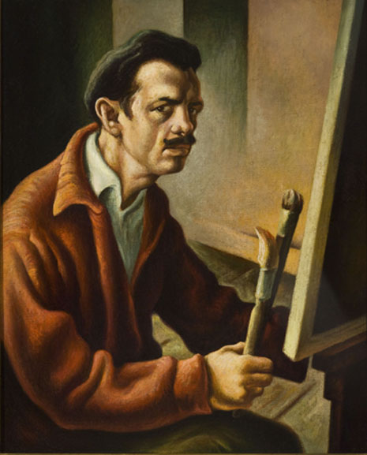
Thomas Hart Benton was born in Neosho, MO, in 1889 into a family of well-known politicians. Though groomed for a political career, he instead became a renowned artist who painted the American scene.

Slide 7
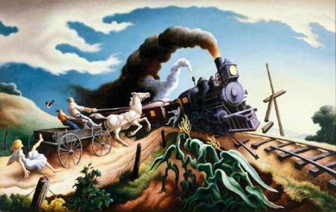
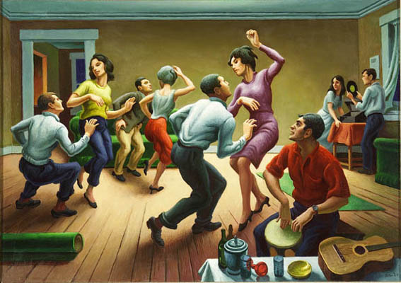
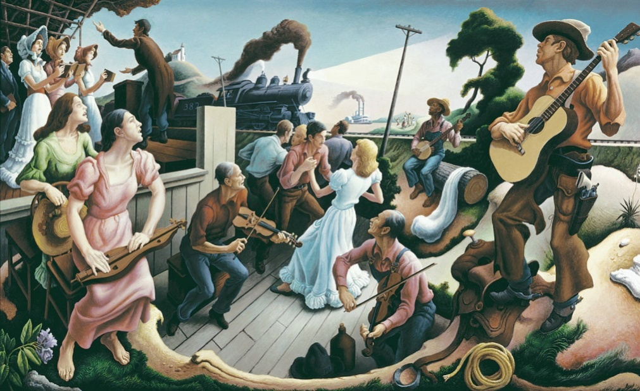
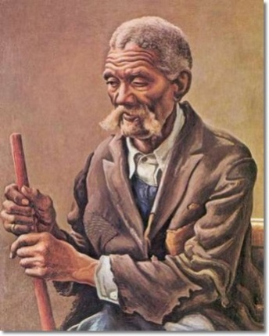
Benton told the stories of everyday Americans in his art using
a style that has been labeled REGIONALISM.
http://www.youtube.com/watch?v=OIX55IJyd7E 3:16

Slide 8
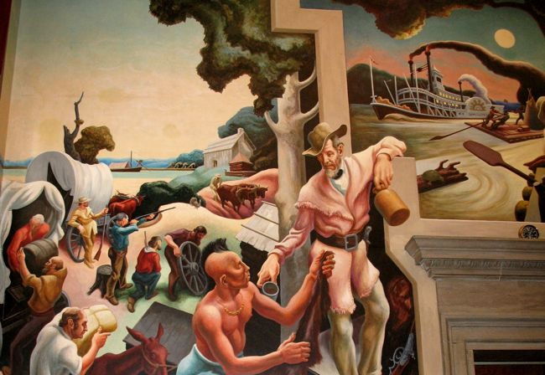
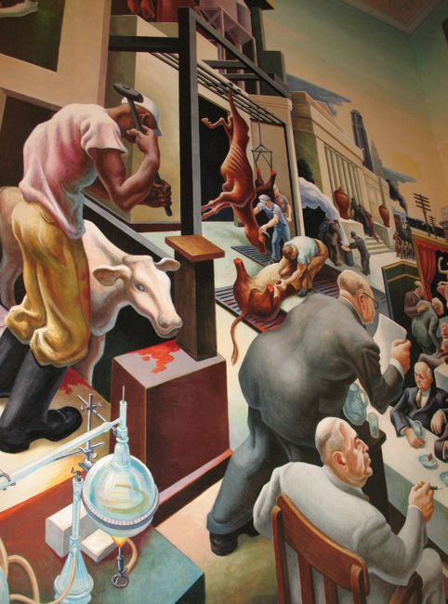
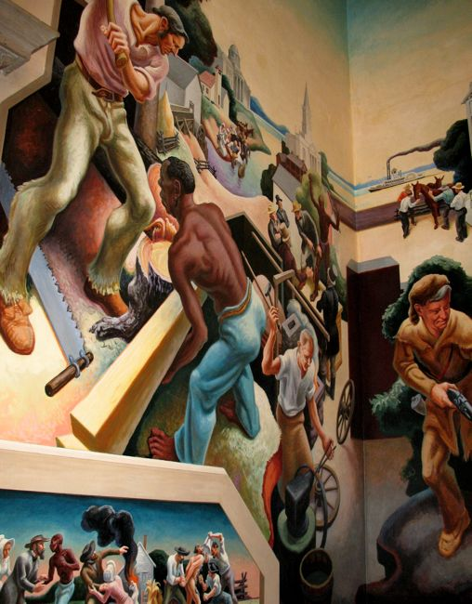
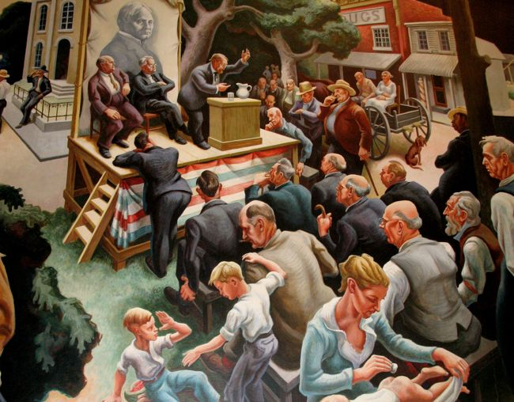
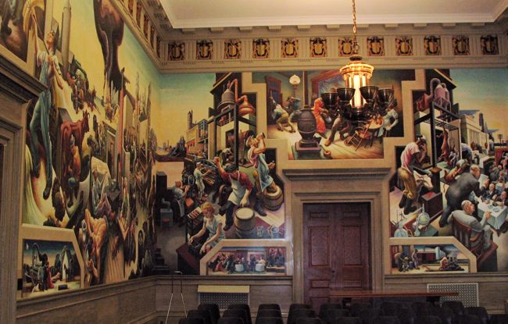
One of Benton’s greatest artistic successes was also his most controversial: a mural at the Missouri state capitol entitled “A Social History of the State of Missouri” which he completed in only 6 months.

Slide 9
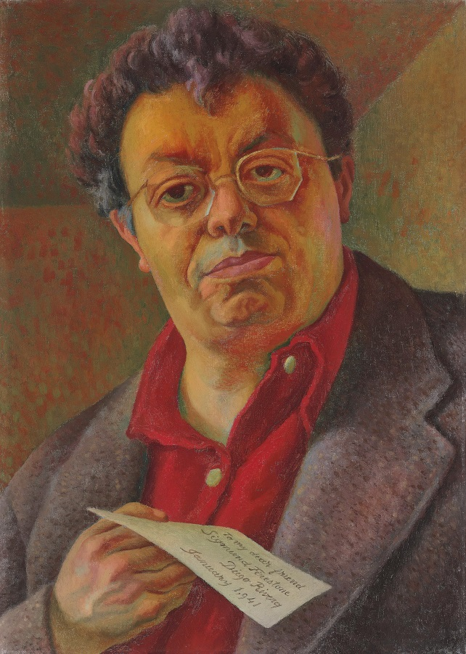
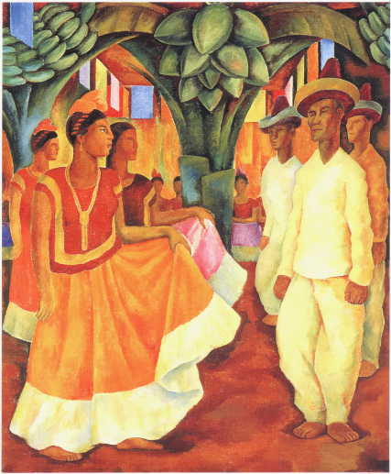
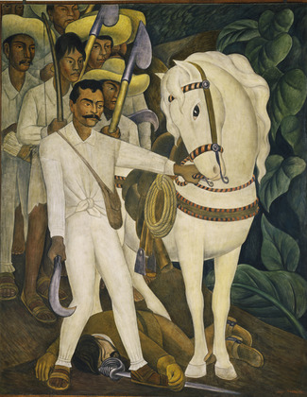
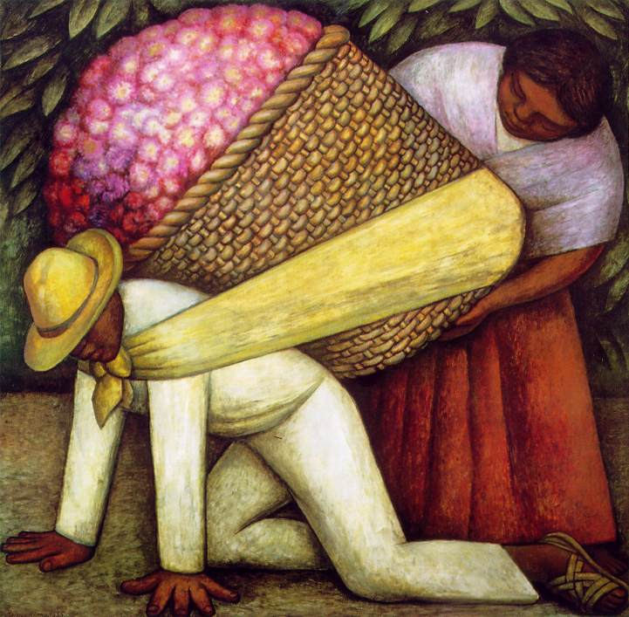
Controversy characterized the life and art of
Mexican muralist Diego Rivera as well. Benton met Rivera in
Paris in the early 1900s. Whereas Benton captured the
life and history of everyday Americans, Rivera visually
narrated the life, history, and politics of the people of México.
http://www.biography.com/people/diego-rivera-9459446/videos (4:02)

Slide 10
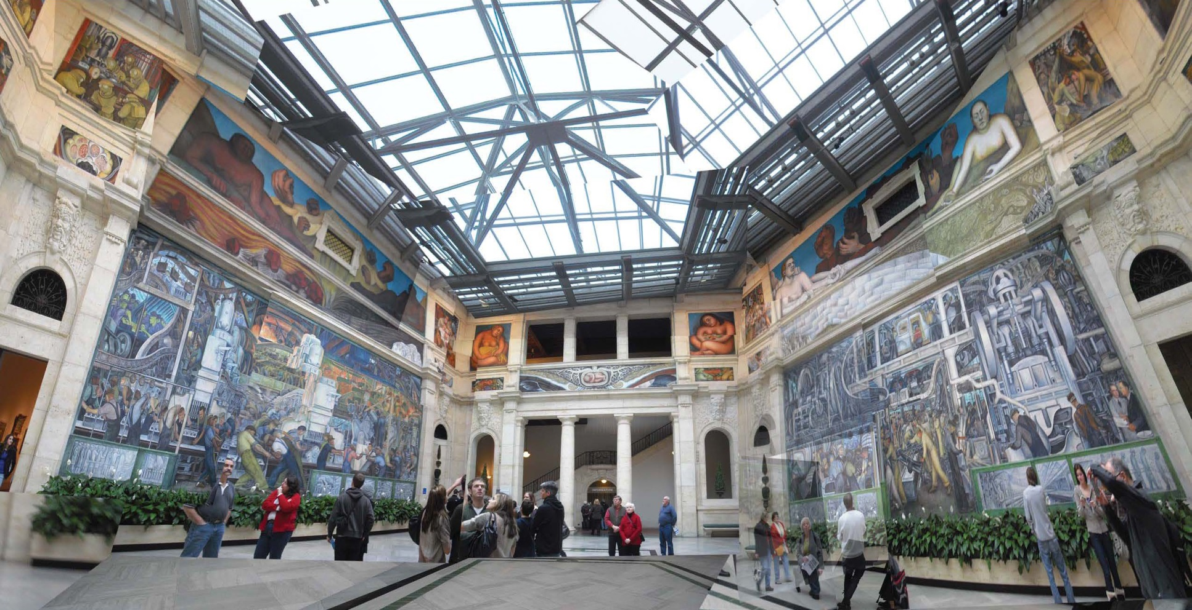
One notable exception, however, is his mural,
“Detroit Industry.”
Its 27 panels grace the walls of the Detroit Institute of Arts.

Slide 11
“Detroit Industry” visually conveys the story of the worker/laborer with a series of murals, which took Rivera 2 years to complete. (Freudenheim, 2010)
Each mural section communicates “an intriguing tension between the people doing the factory work and the monster-like machines” (Freudenheim, 2010) used to accomplish their tasks.
Rivera considered “Detroit Industry” his masterpiece.

Slide 12
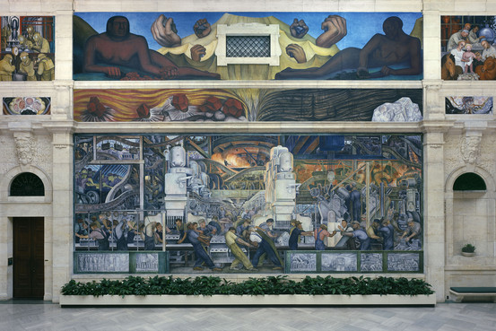
“Detroit Industry, North Wall” Mural by Diego Rivera
http://www.youtube.com/watch?v=MD3qBXv8SGE (5:05)

Slide 13
Benton & Rivera: visual Storytellers
Pink (2005) said:
“Stories are how we remember” (p. 101)
“Stories . . . pack an emotional punch” (p. 103)
“Stories . . . encapsulate, into one compact package, information, knowledge, context, and emotion” (p. 103)
“We are our stories” (p. 115)

Slide 14
Stories through cartoons/caricatures:
DESIGN PROBLEM:
Reflecting upon the social and political stories of Benton and Rivera’s murals, the student will create an editorial cartoon that conveys a message or story about a subject of social interest.
These may be political, social, environmental, or school issues of interest to the student or of potential interest to her/his future students.
The cartoon will visually contain the story elements of character(s), setting, problem, and viewpoint.

Slide 15
Stories through cartoons/caricatures:
STUDIO:
TSW use drawing to create a political/editorial cartoon that may include caricature representation of a cartoon subject
ASSESSMENT:
With Graffiti Boards (includes lesson plan): http://www.eworkshop.on.ca/edu/pdf/Mod36_coop_graffiti.pdf

Slide 16
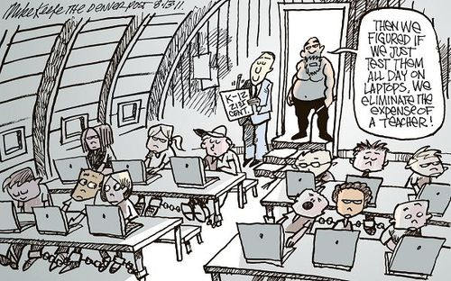
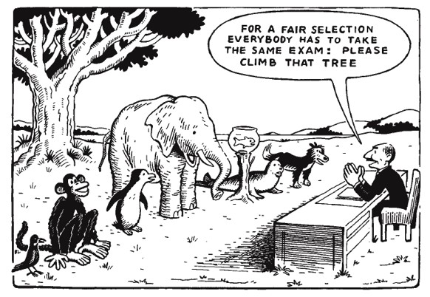
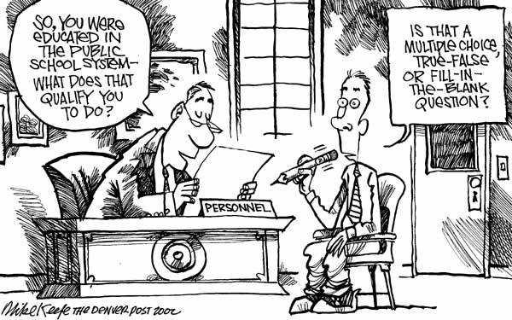

Slide 17
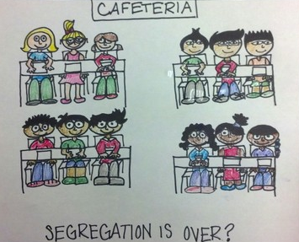
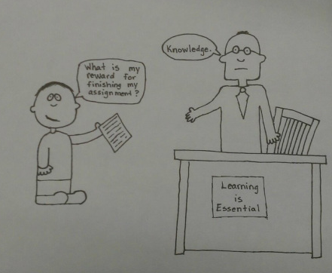
Notes:
Jessica Johnson
Laura Ristau

Slide 18
References
Freudenheim, T. L. (2010, August 14). When the motor city was a symbol of strength. The Wall Street Journal. Retrieved from http://online.wsj.com/article/SB10001424052748704875604575280872067321384.html
Thomas Hart Benton. (n.d.). In Wikipedia Retrieved March 16, 2013 from http://en.wikipedia.org/wiki/Thomas_Hart_Benton_%28painter%29

